Slide 1
Computer Project-I
BCA 1st Semester
Submitted by:
Nidan Shrestha (Symbol no: 314887)
Raj Shrestha (Symbol no: 314892)
Jupiter Bade (Symbol no: 314883)
Milan Man Sing Khadka (Symbol no: 314886)

Slide 2
Introduction
Our Project “Who Will Become Millionaire” is a game based on real game show called “Who Wants to Be Millionaire?”/ “ KBC”.
In this program, user can:
Play Game
View score list
Add questions through admin mode

Slide 3
Objective
To play game (Who Will Become Millionaire)
To save the score record and view other saved records.
To add questions through admin mode.

Slide 4
Scope
To increase IQ of User.
To gain knowledge.
To passing time when bored.

Slide 5
Methodology
We collect information from book, Google, Youtube, teacher and Friends.
Our group member collected ideas from Similar games(KBC).
Algorithm
Flowchart

Slide 6
Algorithm
1. Play game
Step 1: Start
Step 2: Input name
Step 3: Open question file in read binary mode
Step 4: Answer the questions
Step 5: Display the score and user’s name
Step 6: Save the name and score
Step 7: Ask to go to main menu or exit
Step 8: Stop.

Slide 7
2. Score list
Step 1: Start
Step 2: Open score.txt in read mode
Step 3: Display all name and score from score.txt
Step 4: Ask to go to main menu or exit
Step 5: Stop.

Slide 8
3. Admin mode
Step 1: Start
Step 2: Input id number for question
Step 3: Input question
Step 4: Input four options
Step 5: Input correct answer’s id number
Step 6: Store the data in question file
Step 7: Display success
Step 8: Ask to store another question if not exit.
Step 9: Stop.

Slide 9
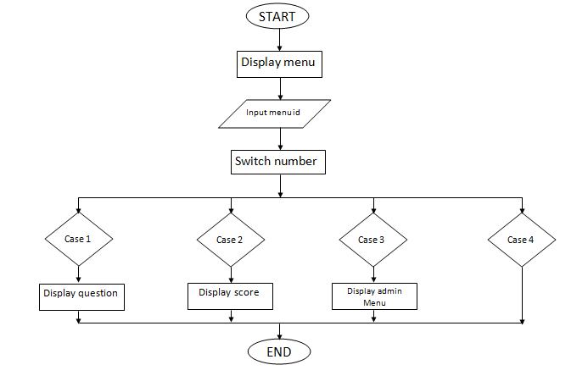
Flowchart

Slide 10
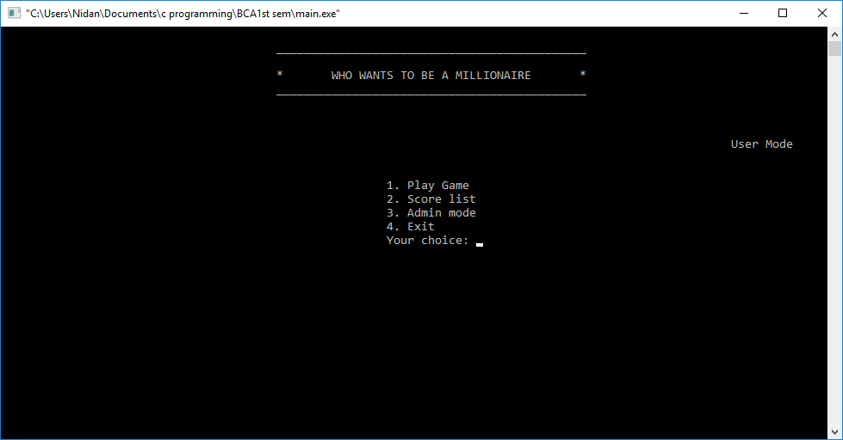
Test and References
To avoid various errors in program we added if condition, so that is a user enters a wrong value, the program allows user to enter the value again until the entered value is correct.
We used user defined function to make the program systematic.
Main Menu

Slide 11
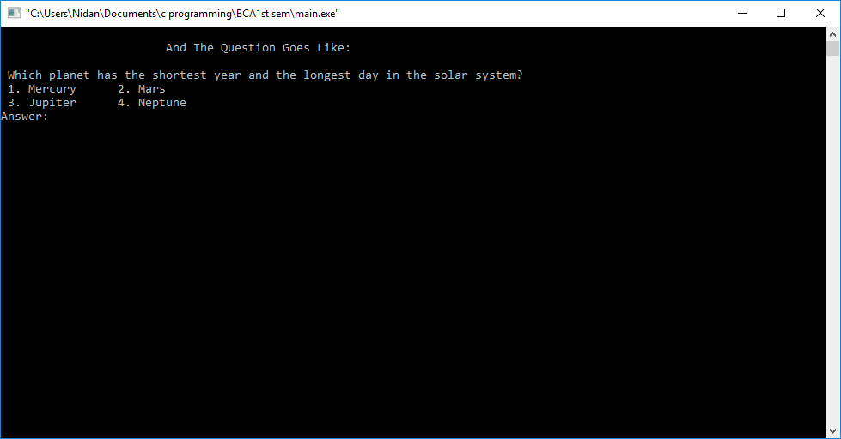
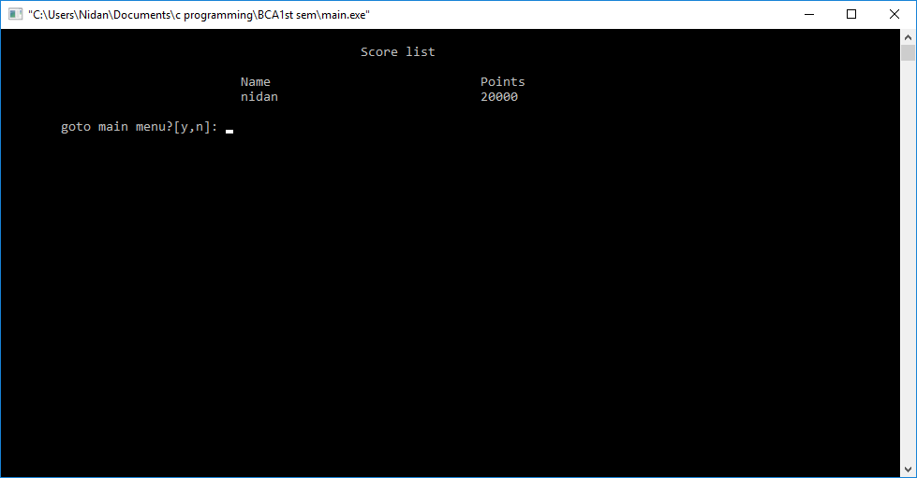
Play Game
Score Menu

Slide 12
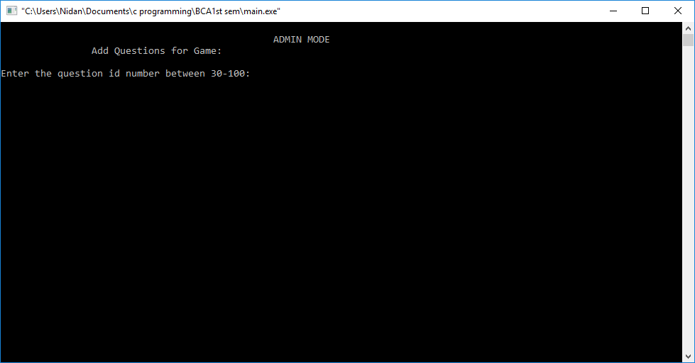
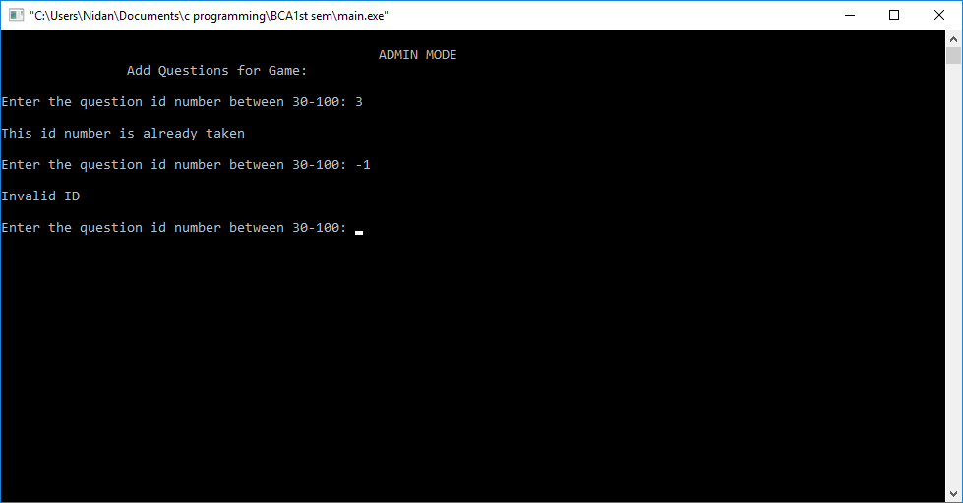
Admin Menu
If invalid number is entered

Slide 13
Conclusion
We worked very hard to complete this project. Although we had many difficulties, we overcome by learning new library functions of c programming.
So, with all the hard work we are successful to achieve our goal.

Slide 14
Thank You

